Slide 1
Queue
Data Structures
CS 2014
By
Marwa M. A. Elfattah

Slide 2
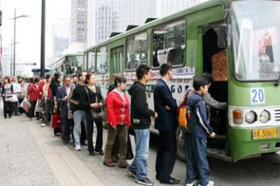
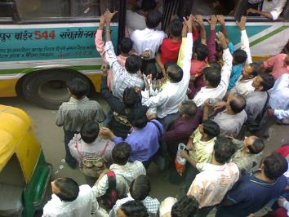
Queue - What?

Slide 3
Queue- What
Queue is Linear - non-primitive data structure
Queue is a homogeneous collection of elements.
In which new elements are added at one end called rear or tail, and the existing elements are deleted from other end called front or head.
So, the Queue is called First-in-First-out (FIFO)
Examples of queues: Toll Station, Check-out in Big super market, Printer, …

Slide 4
Queue- What
20
Add (20)
Add( 5)
Add(30)
Delete
Delete
Add(0)
Add( -3)
5
0
30
-3

Slide 5
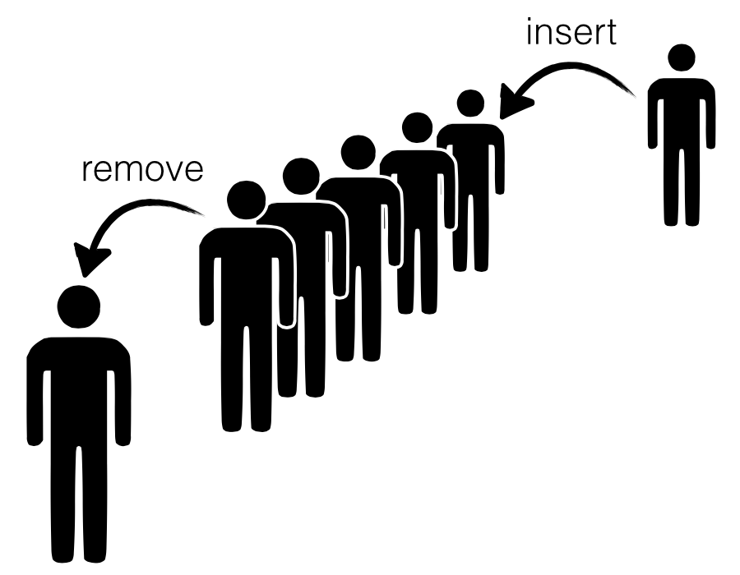
Queue
?
Implementation
User View

Slide 6
OPERATIONS PERFORMED ON QUEUE
Create the queue, leaving it empty.
Determine whether the queue is empty or not.
Determine whether the queue is full or not.
Enqueue a new entry onto the end of the queue
Dequeue the entry at the front of the queue.

Slide 7
Queue Implementation
#define MAX 10
typedef char EntryType;
typedef struct {
int front;
int rear;
EntryType entry[MAX];
} QueueType;

Slide 8
Queue Implementation
A queue
After A leaves,
After B and C leave
How can we insert a new element?!!
D
C
B
A
Max
rear
front
D
C
B
Max
rear
front
K
G
I
H
G
F
E
D
Max
rear
front

Slide 9
Queue Implementation
One solution is to shifting all items to front when dequeue operation.
After A leaves,
After B and C leave
Too Costly…
D
C
B
A
Max
rear
front
D
C
B
Max
rear
front
Max
G
F
E
D
rear
front

Slide 10
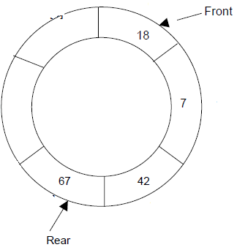
Queue Implementation
A better solution is a circular Queue

Slide 11
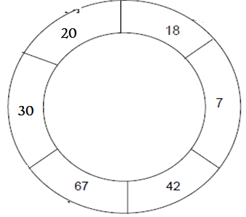
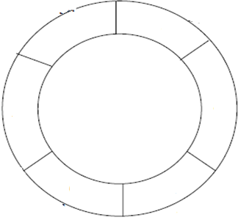
Circular Queue
rear
front
front
rear
One solution is to keep track with the number of elements on each queue
Size = Max
Size = 0
Full Queue
Empty Queue
In both cases front comes after rear with one step. Then, how can we distanguish between the two cases?!!

Slide 12
Queue Implementation
#define MAX 10
typedef char EntryType;
typedef struct {
int front;
int rear;
int size;
EntryType entry[MAX];
} QueueType;

Slide 13
Queue Implementation
Create operation:
  Pre: None.
  Post: The queue is initialized to be empty.
  void CreateQueue(QueueType *q){
  q->front= 0;
  q->rear = max -1;
  q->size = 0;
}

Slide 14
Queue Implementation
Queue empty operation:
  Pre: The queue is initialized.
  Post: If the queue is empty (1) is returned. Otherwise (0) is returned.
  int QueueEmpty(QueueType q){
  return (q.size==0);}
Queue full operation:
      Pre: The queue is initialized.
  Post: If the queue is full (1) is returned. Otherwise (0) is returned.
  int QueueFull(QueueType q){
  return (q.size==MAX);}

Slide 15
Queue Implementation
Enqueue operation:
  Pre: The queue is initialized and is not full.
  Post: Item is added to the end of the queue.
  void Enqueue(EntryType item, QueueType *q){
  q->rear ++;
  q->rear = (q->rear+1)%Max; // to circulate
  the queue
  q->entry[q->rear] = item;
  q->Size ++;
  }
It is for linear not circular

Slide 16
Queue Implementation
Dequeue operation:
  Pre: The Queue is initialized and is not empty.
  Post: The front element of the Queue is removed from it and is assigned to item.
  void dequeue (Entry *item, QueueType *q){
  *item = q->entry[ q->front];
  q->front = (q->front +1)% MAX
  q->Size--;
  }

Slide 17
Exercise
In the implentation level of the queue ADT, write the QueueTraverse which is defined as :
void TraverseQueue(QueueType* pq, void (*pf)(Entry *))
Where pf is a pointer to a function that is passed over all of the queue *pq elements to perform a task
Use the previous function to print on the screen all a queue elements in the user level.

Slide 18
Exercise
  void TraverseQueue(Queue* q, void (*f)(EntryType*)){
  int i, siz;
  for(i=q->front, siz=0; siz<q->size; siz++){
  (*f)(&q->entry[i]);
  i=(i+1)%MAX;
  }
  }
Print(&q->entry(i))
Or
Increment(&q->entry(i))
Or
…
could
be

Slide 19
Exercise
void Print(EntryType *e){
printf(“e is: %d\n", *e);
}
void main(){
QueueType q;
CreateQueue(&q);
…
TraverseQueue(&q, &Print);
}

Slide 20
Thank you

